Slide 1
WHO analysis
File created on: 12/23/2022 5:04:43 PM

Slide 2
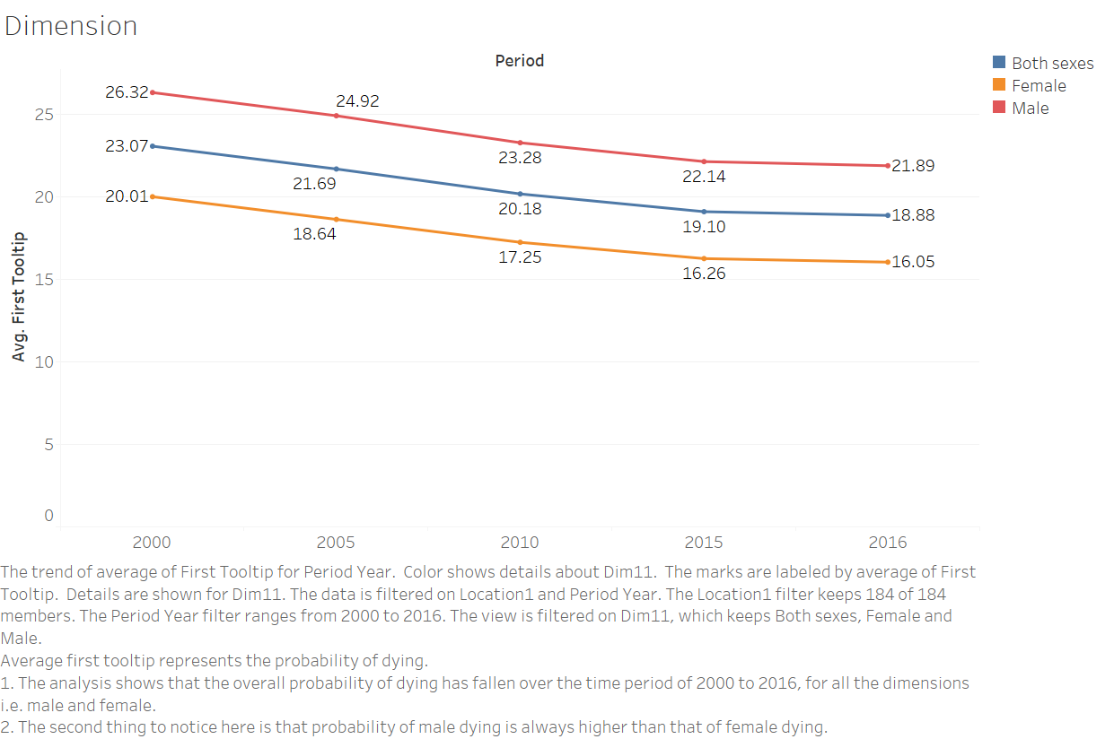

Slide 3
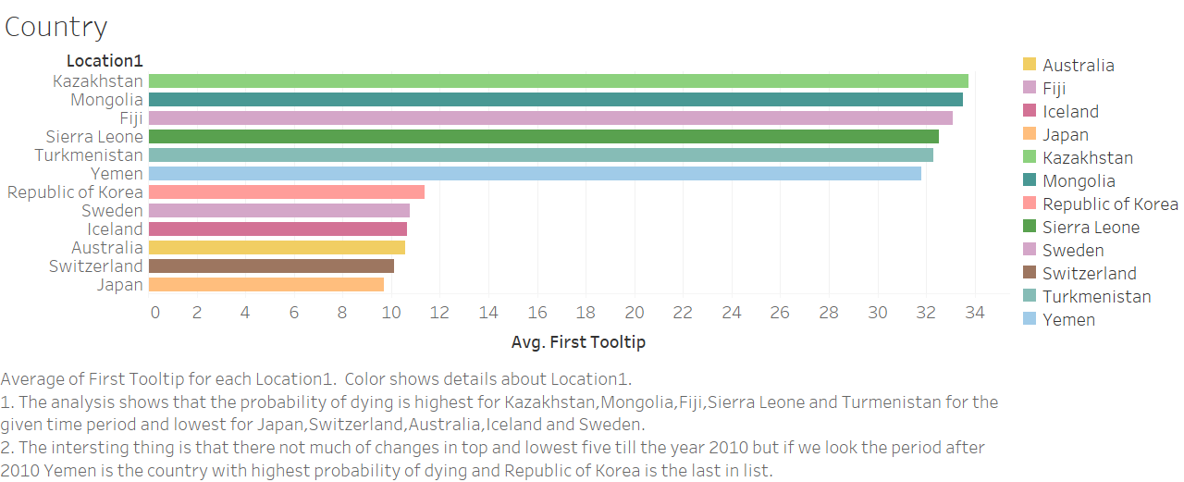

Slide 4
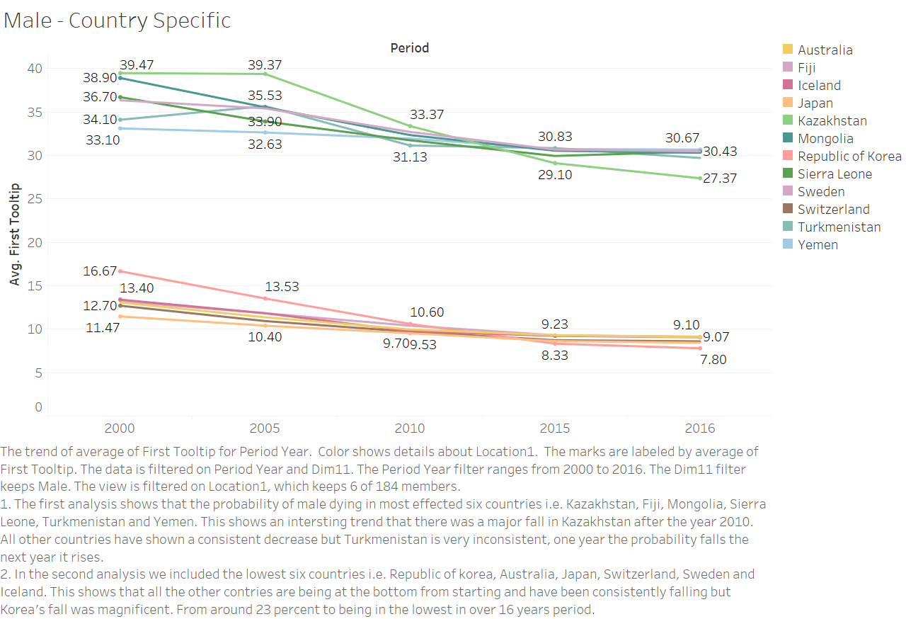

Slide 5
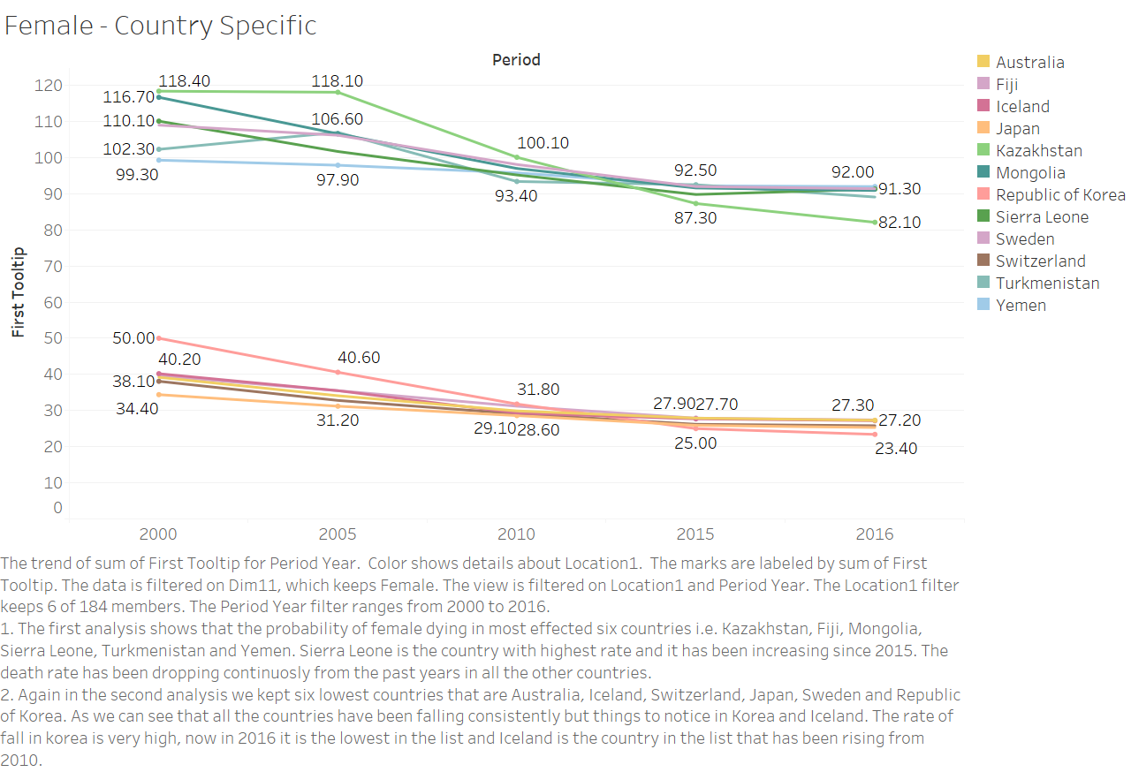

Slide 6
